Slide 1
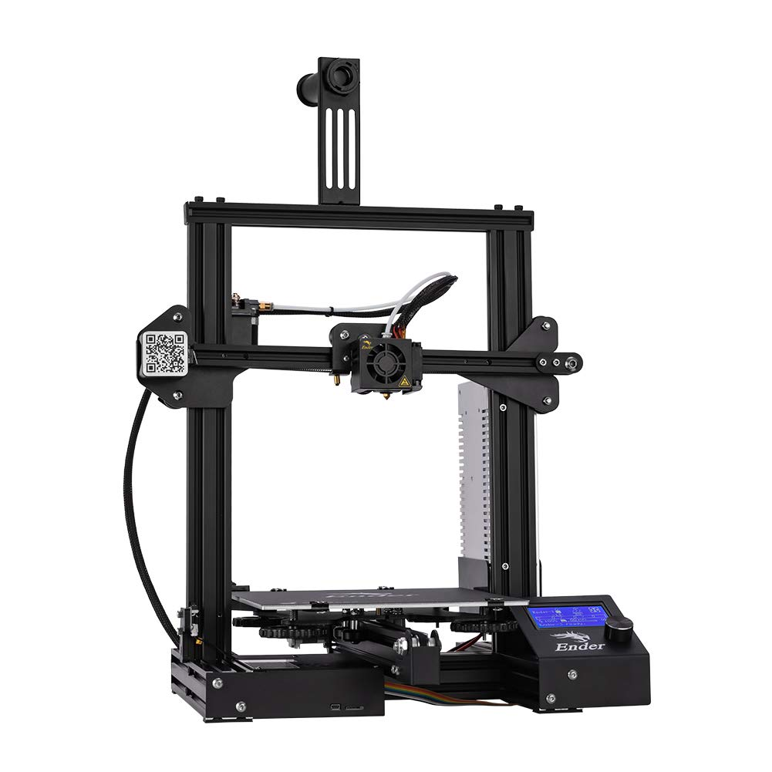

Team 21: 3D Printer and Application Interface
Bi-Weekly Update 1 Cody Hutchison Steven Liu Abigail Morar Sponsor: Dalton Cyr TA: Milenka Gamero
Notes:
Michelle

Slide 2
Project Summary
Current 3D printers require the user to manually upload a G-code file by an external storage device and initiate the printing process via controls on the printer
The new 3D printer and Application will allow the uploading, controlling, and initiation of printing from anywhere with internet access. The print time will also be within 10% of the Ender 3 printing time while also attempting to speed up the Z-axis movement speed.
Notes:
Kyle

Slide 3
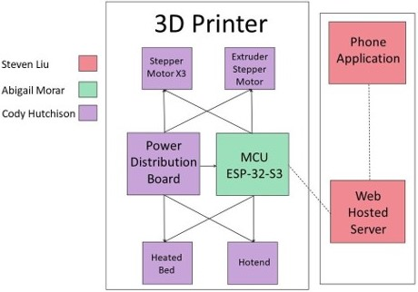
Project/Subsystem Overview
Notes:
Eric

Slide 4
Project Changes for 404
Everything is still on track from what was planned in 403.
As of now, changes are mostly geared towards fixing bugs in the current subsystems, preparing for full integration, and dealing with whatever problems may arise from that.
Notes:
Eric

Slide 5
Project Timeline
Validate System
Finish Subsystems
Integrate Subsystems
Final Presentation
Final Demo
February 15
March 15
March 29
April 10
April 24
Notes:
January 30th - February 5th
Ensure all parts required to complete PCBs are on hand or order more
Start populating PCB if they have arrived
February 6th - 12th
Have PCB populated and validate

Slide 6
Electrical Subsystem
Cody Hutchison
Accomplishments since 403 55 hrs of effort | Ongoing progress/problems and plans until the next presentation
- Redesigned and corrected errors with the the Stepper Motor Driver PCB. - Minor modifications to the Controller PCB due to a header component used to plug the MCU being incorrect - Placed order for new PCB boards | - Verify there are enough leftover components to populate both PCBs - Populate both PCBs - Validate both PCBs

Slide 7
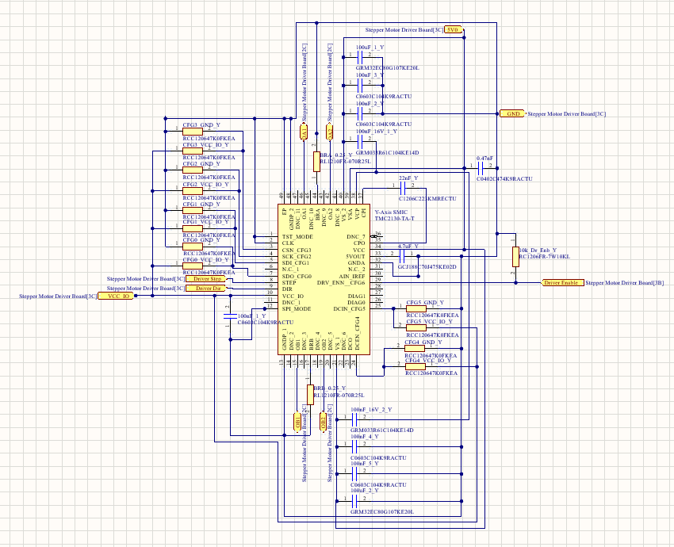
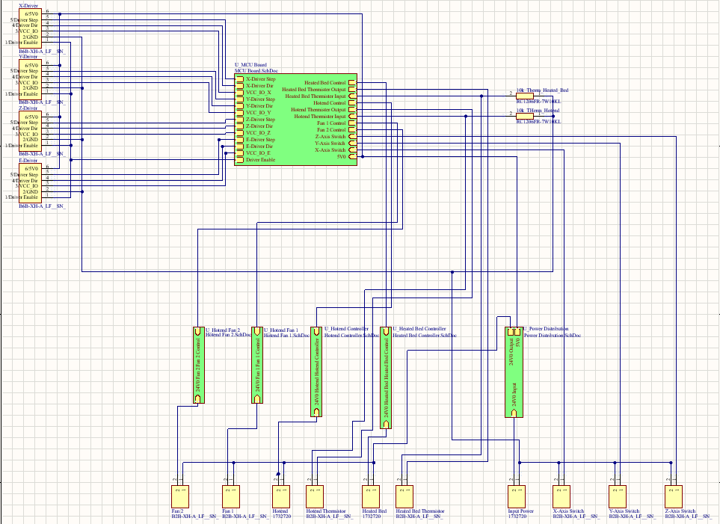
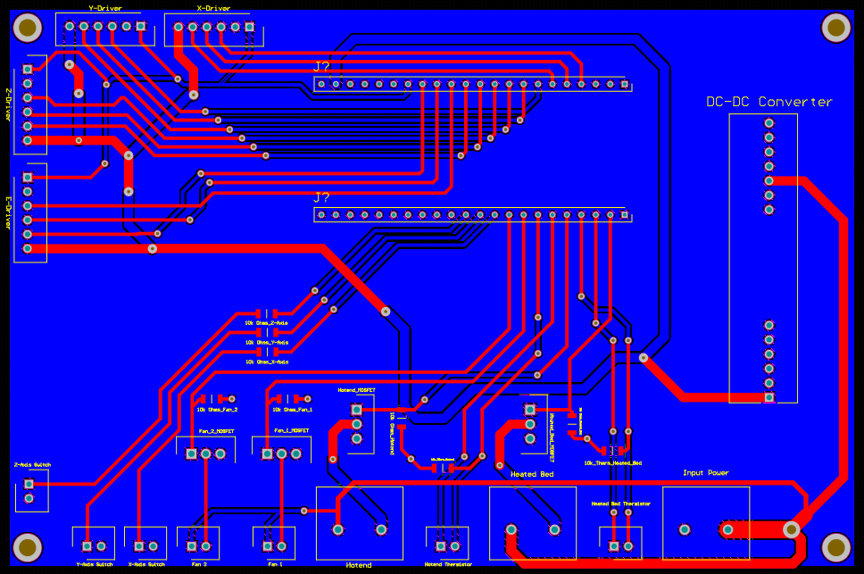
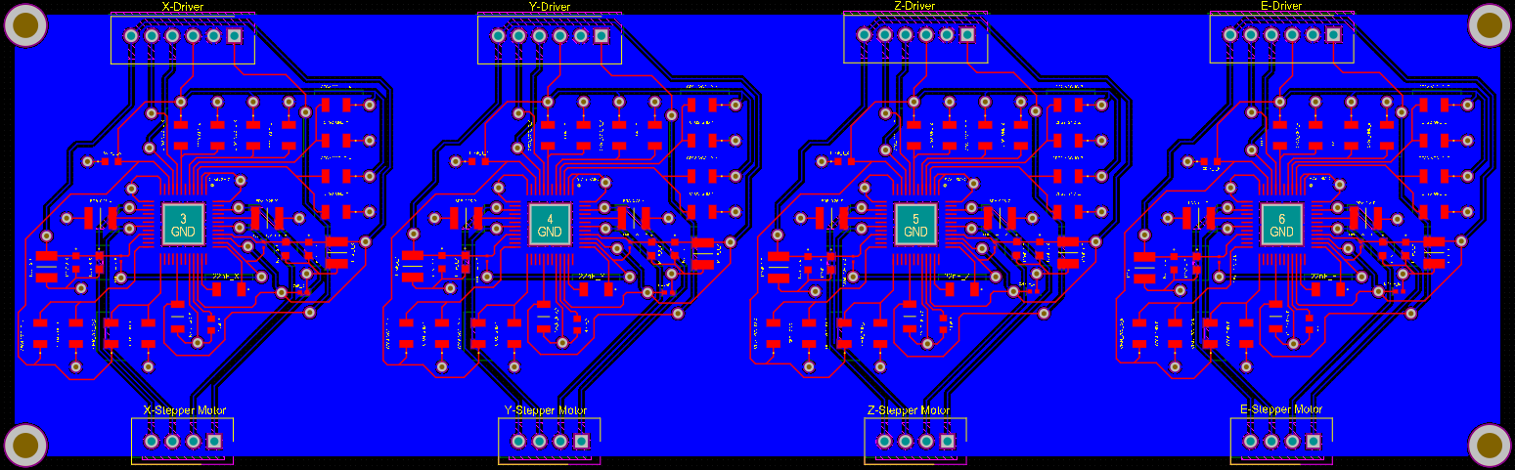
Electrical Subsystem
Cody Hutchison

Slide 8
Application and Server Subsystem
Steven Liu
Accomplishments since 403 15 hrs of effort | Ongoing progress/problems and plans until the next presentation
- Added security rules to server - Improved application UI - Incorporating Android SharedViewModel class to fix bug | - Finish incorporating SharedViewModel class to app and validate - Work on fixing other bug - Find other possible UI improvements - Work on connecting with MCU subsystem

Slide 9
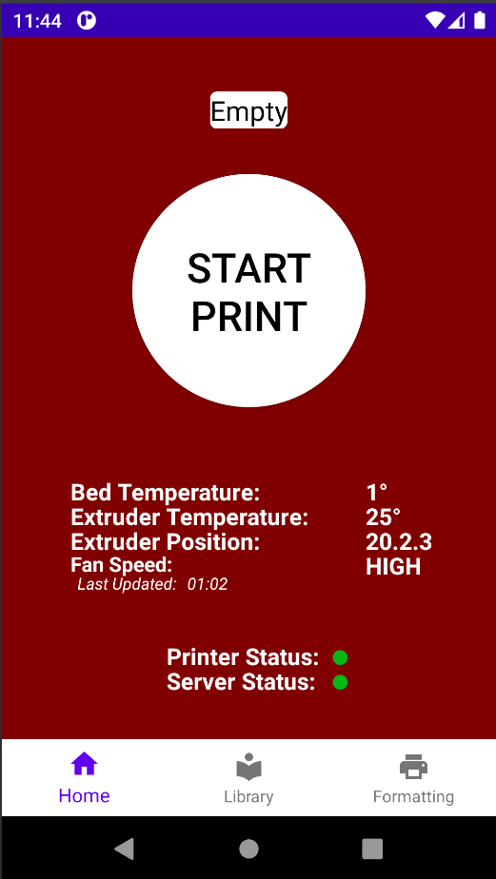

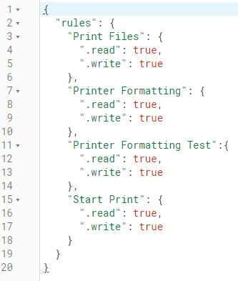
Application and Server Subsystem
Steven Liu

Slide 10
Microcontroller Programming Subsystem
Abigail Morar
Accomplishments since 403 10 hrs of effort | Ongoing progress/problems and plans until the next presentation
- Ensured all code still works and can connect to server - Combined code, has some bugs | - Fix bug with reading from Firebase and other issues - Adding code to check for updates from phone app to interrupt G-code reading process, update, then resume or cancel - Waiting on integration with motors to calculate the steps to mm

Slide 11
Parts Ordering Status
PCBs are currently on order
Order PCB components
Notes:
Michelle

Slide 12
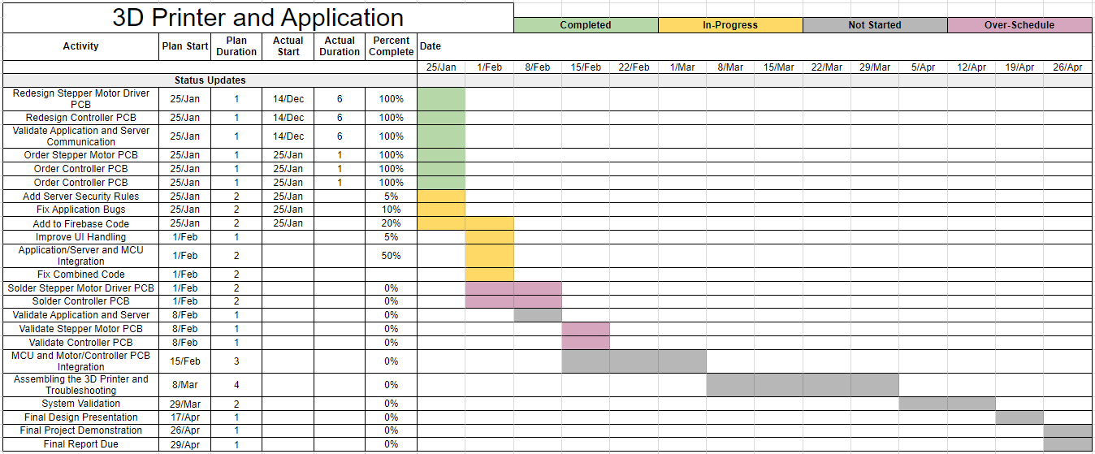
Execution Plan
Notes:
Michelle

Slide 13
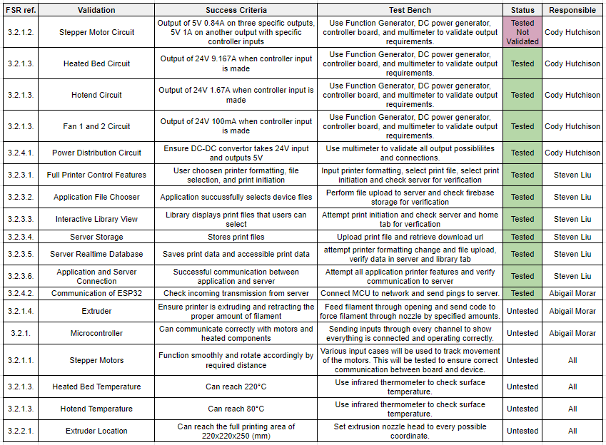
Validation Plan
Notes:
Michelle

Slide 14
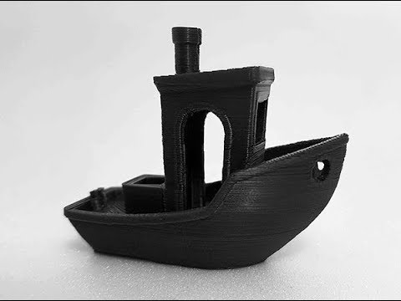
Questions? Comments?
Thank You

